Slide 1

TPSA-Mobile, Alabama
February 7, 2013
NMDA
Pesticide Disposal Program (PDP)
Cary C.S. Hamilton
Registration Program Manager
NMDA-AES, Pesticide Compliance Section
PO BOX 30005, MSC-3AQ
3190 South Espina
Las Cruces, NM 88003-8005
Office: 575-646-7020
Fax: 575-646-5977
chamilton@nmda.nmsu.edu

Slide 2
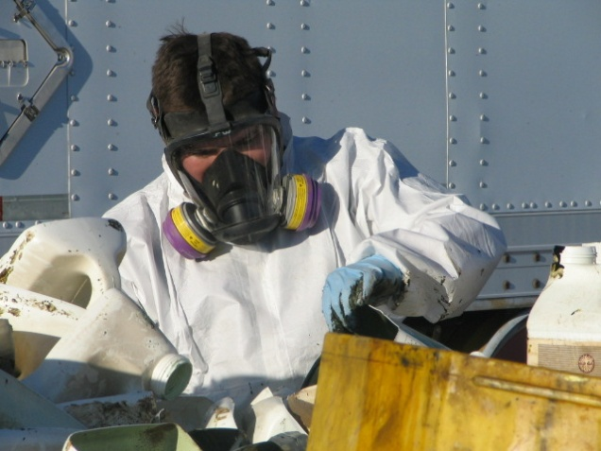
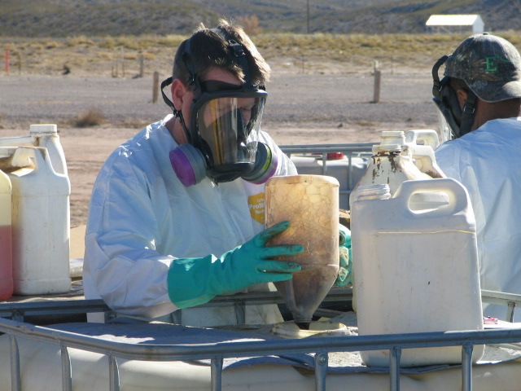
NM PDP
  Partnership
  Contract/Years
  RFP/NMSU
    Requirements
  Locations
  Sites
  Setting
  2013 Year
  Totals
  Amounts
  Type of Products
  Years
  Additional Information
  Registration
  Successes
  TCB

Slide 3
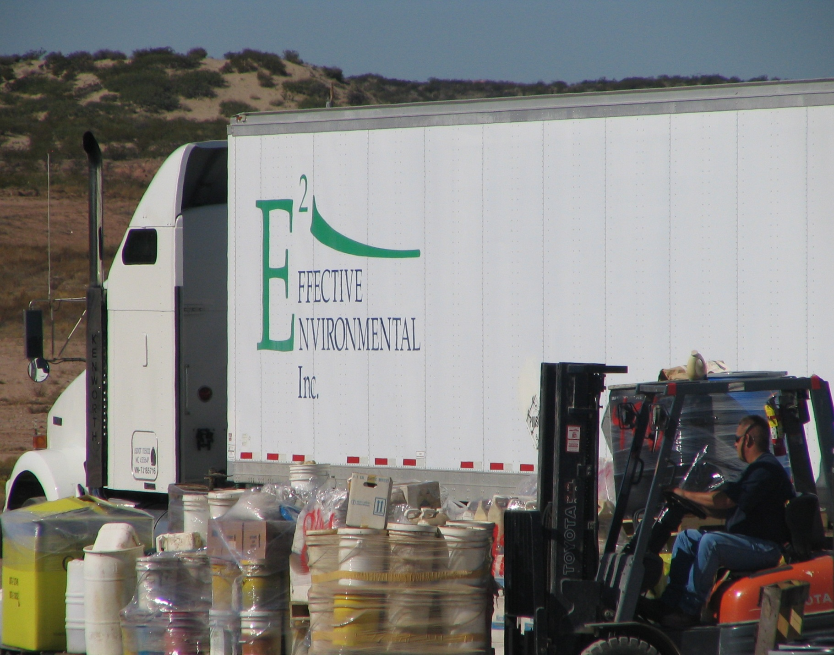
Partnered With
First Year
4 years
Reports
Electronic Format

Slide 4
New Mexico: PDP Locations
Legend
Created By: C. Hamilton
NMDA
February 1, 2013

Slide 5
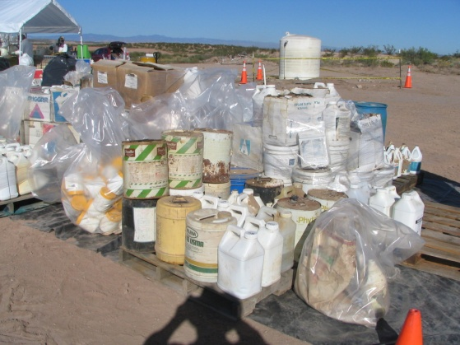
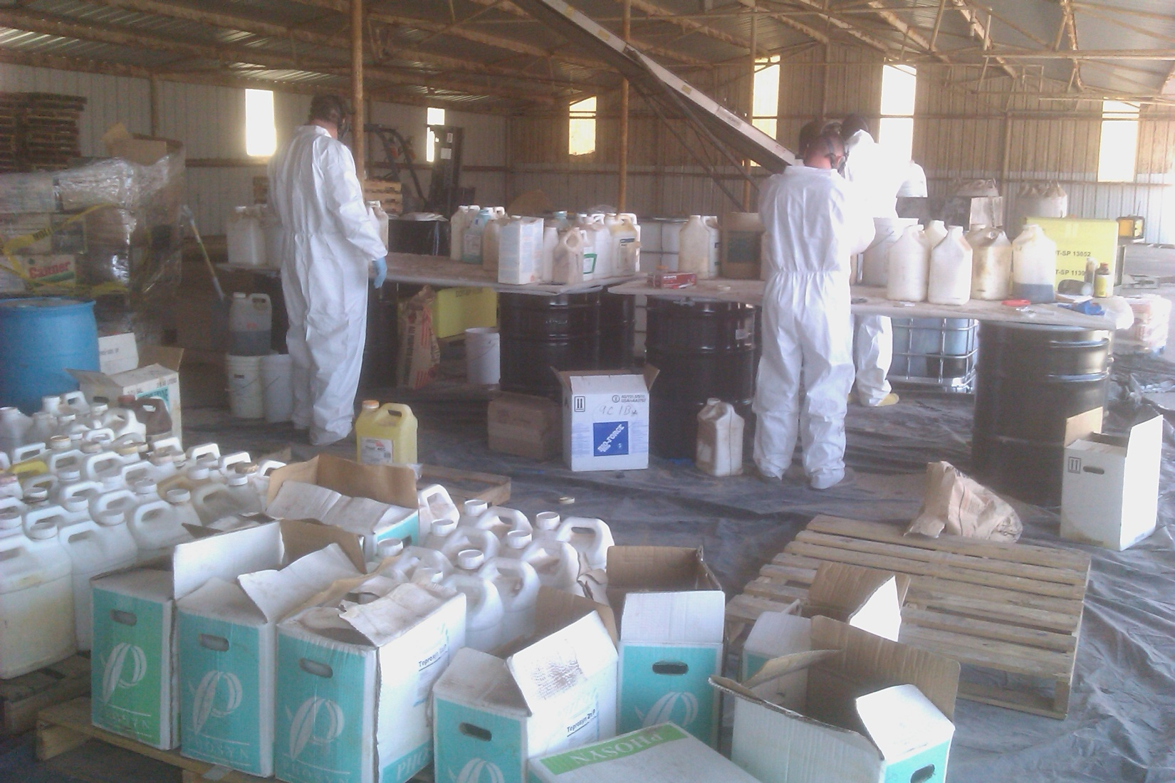
Totals
CPS, Vado, NM. October 2007:
    Total Pounds: 78,194
Hatch Airport, Hatch, NM. December 2007:
This was a follow up run to # 1.
    Total Pounds: 15,449
UAP, Artesia, NM. January 2008:
    Total Pounds: 30,946
Private Farm, Clovis, NM. November 2008:
    Total Pounds: 25,463
Cotton Gin, Deming, NM. October 2009:
    Total Pounds: 45,012
NMSU Farm, Los Lunas, NM. June 2010:
    Total Pounds: 18,076
NAPI, Farmington, NM. November 2010:
    Total Pounds: 17,236
CPS, Artesia, NM. November 2010:
    Total Pounds: 23,882
NMDA Lab, Las Cruces, NM. April 2011:
    Total Pounds: 956
County Fair Grounds, Socorro, NM. June 2012:
    Total Pounds: 4,200
CPS, Vado, NM. Hatch, NM & Lab. June 2012:
    Total Pounds: 14,676
A total of 274,090 pounds of agricultural pesticide products have been removed and disposed.

Slide 6
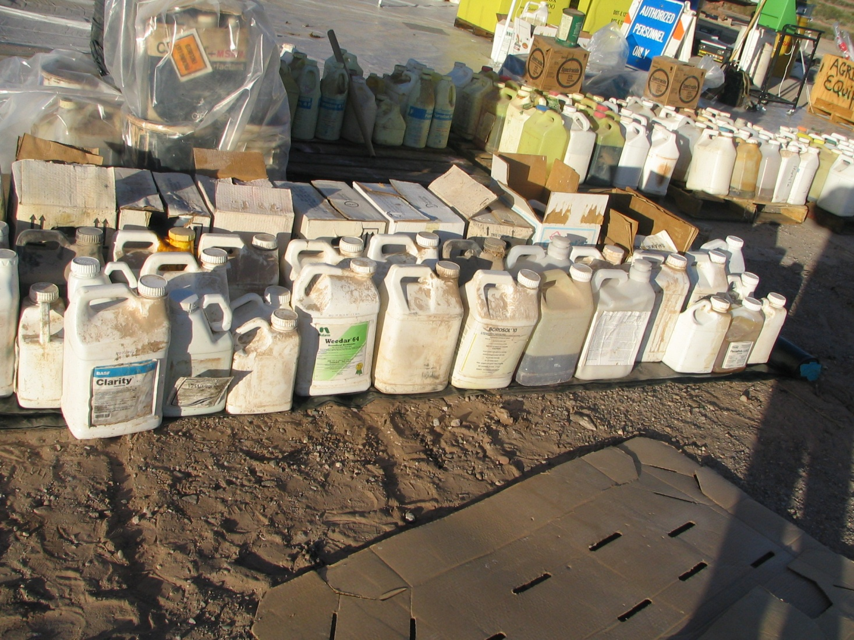
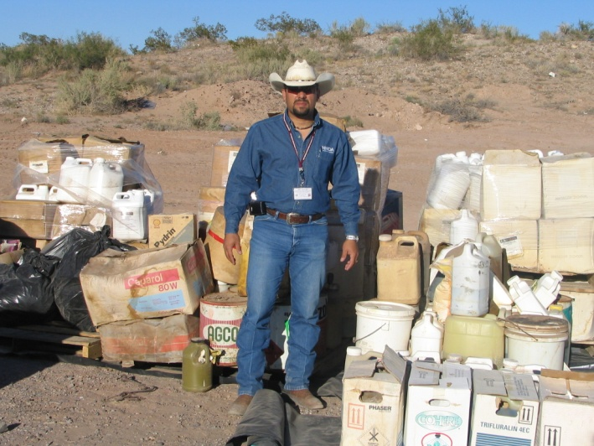
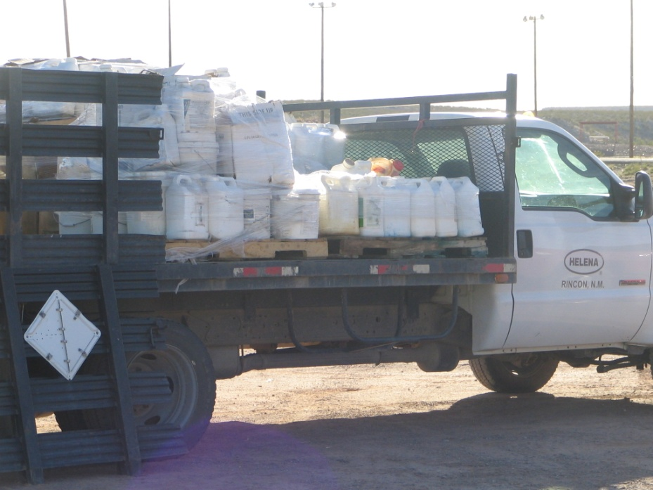
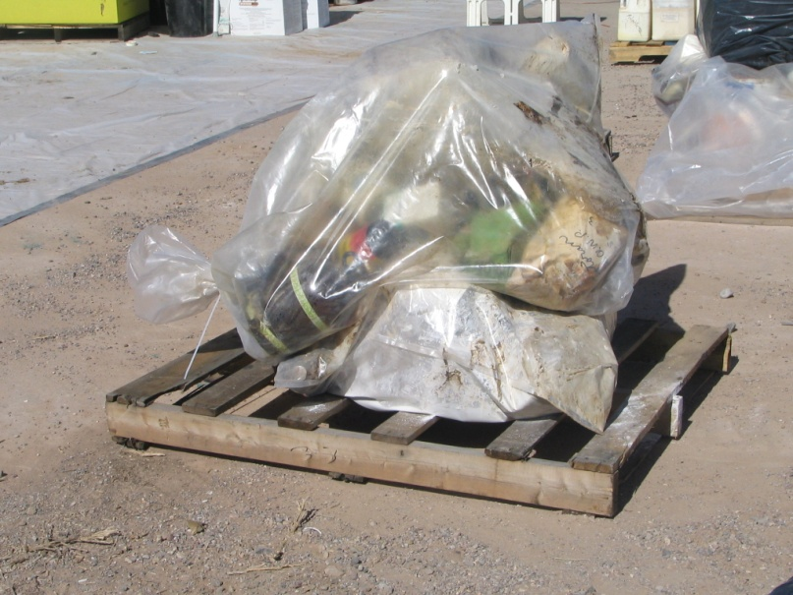
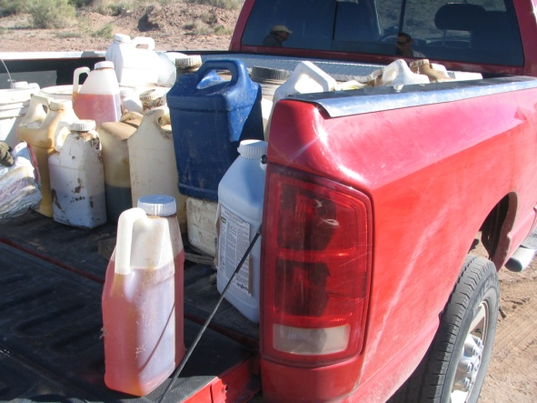
  Additional Information
  Registration
  Successes
  TCB

Slide 7
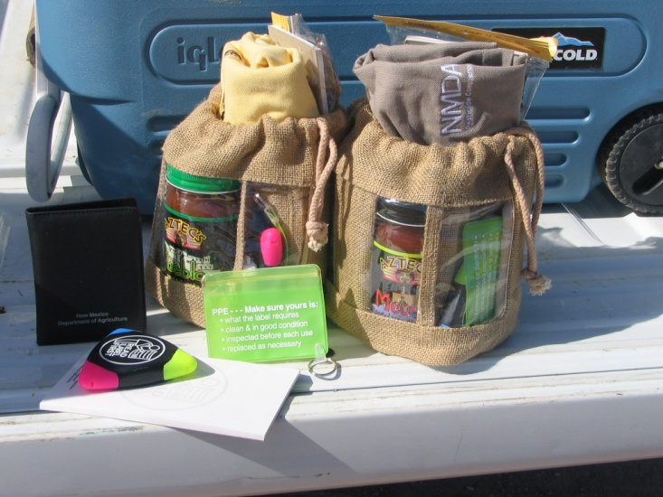
Registration Form
Pre Register
Fax
Phone
Mail
E-Mail

Slide 8

Any Questions?
Cary C.S. Hamilton
Senior Program Specialist
New Mexico State University
NMDA-AES, Pesticide Compliance Section
PO BOX 30005, MSC-3AQ
3190 South Espina
Las Cruces, NM 88003-8005
Office: 575-646-7020
Fax: 575-646-5977
chamilton@nmda.nmsu.edu

