Slide 1
Canadian Obsolete Stocks Program and the Inclusion of Animal Health Products
The Pesticide Stewardship Alliance Conference
Mobile, AL
February 7, 2013
Russel Hurst
CleanFARMS

Slide 2
Discussion Outline
Introduction of CleanFARMS
Overview of Obsolete Pesticide Collection Program in Canada
Inclusion of Animal Health Products
Lessons Learned
Future opportunities

Slide 3
Who is CleanFARMS™?
Industry Stewardship Organization
Federally incorporated not-for-profit
Private sector Board
Current members: manufacturers/distributors of crop protection products
Operate voluntary (except where mandated)

Slide 4



























32 members – manufacturers, developers, distributors of crop protection and fertilizer products

Slide 5


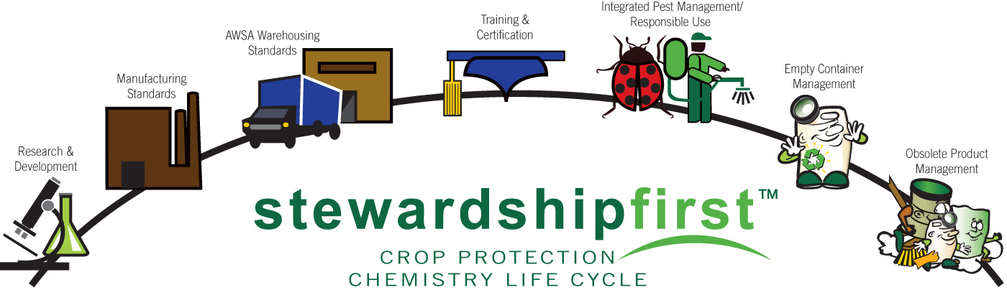
Crop Protection Stewardship Responsibilities – 22 years of programming

Slide 6



CleanFARMS Inc.
Three current permanent programs:
Empty container management
- National program
Obsolete pesticide collection
- National program
Empty paper bag collection
- offered in PEI, NS, NB
- will expand across Canada

Slide 7
Canadian Agriculture:
Key Comparisons
 | Canada
Population | 33,500,00
Arable Land Base | 992,000,000 Ha 67,600,000 Ha (farm area) 35,900,000 Ha (crop production)
Number of Farms | 229,600 holdings
GDP (% of National) | 2% Primary Agriculture ($42 B) Pesticides ~ $1.8 B
Average farm size | 300 ha (nationally) Ave Age ~ 52 years
Notes:
http://www.ers.usda.gov/statefacts/us.htm for US

Slide 8

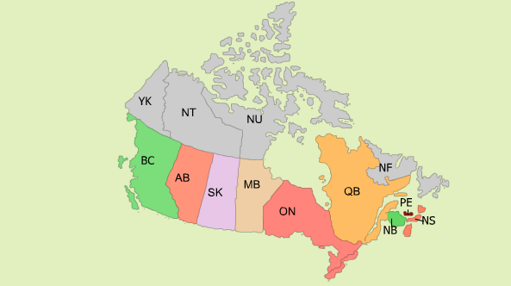

Province | Pop (million)
BC | 4.5
AB | 3.7
SK | 1.0
MB | 1.2
ON | 13.1
QC | 7.9
Atlantic (3) | 2.6
TOTAL | 34
Four key Canadian growing regions

Slide 9
Obsolete Pesticide Collection Program
Key Accomplishments:
Over 2.8 Million kgs (6.16 Million Lbs) collected and destroyed since 1998
Provincial collections every 3 years, free for farmers to participate
Excellent support from stakeholders governments (co-funding disappearing)
Looking at additional materials (animal health)

Slide 10
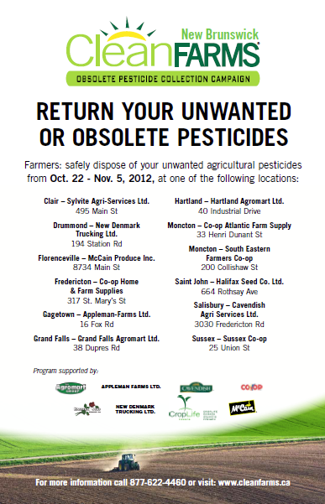
Obsolete Pesticide Collection Program
New Brunswick Summary
Hosted at 12 ag retails for a period of 2 weeks in Oct ’12
Program funded by CleanFARMS (govt funding in Atlantic Canada has ceased)
13,370 kgs collected ($51K)
  7,010 Kg (‘07)

Slide 11
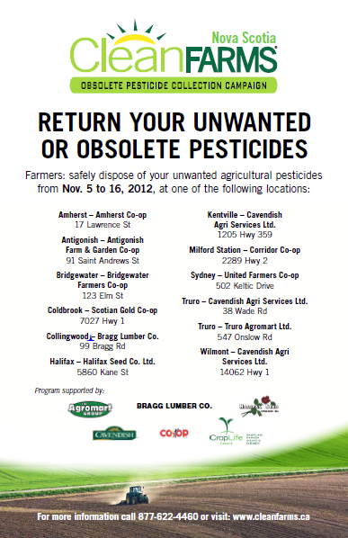
Obsolete Pesticide Collection Program
Nova Scotia Summary
Hosted at 12 ag retails for a period of 2 weeks in Nov ’12
Program funded by CleanFARMS (govt funding in Atlantic Canada has ceased)
13,829 kgs collected ($53K)
  16,132 kgs (’07)

Slide 12
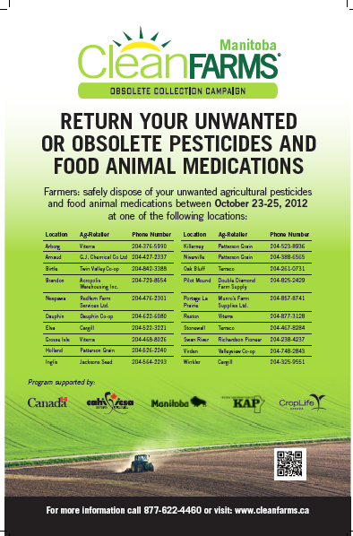
Obsolete Pesticide Collection Program
Manitoba
Hosted at 20 ag retails from Oct 23-25
Program funded by CleanFARMS and MB Govt ($50K)
74,502 kgs collected,
340 kgs animal health
  16,132 kgs (’07)

Slide 13
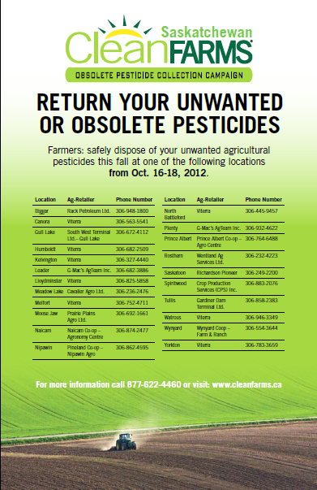
Obsolete Pesticide Collection Program
Saskatchewan
Hosted at 22 ag retails from Oct 16-18 in northern half of province
Program funded by CleanFARMS (no government funding)
60,396 kgs collected
  35,355 Kgs in 2011 (Southern half)
  124,516 kgs in 2007

Slide 14
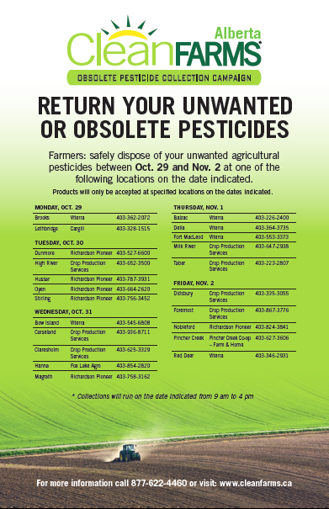
Obsolete Pesticide Collection Program
Alberta
Hosted at 22 ag retails from Oct 29-Nov 2 in southern half of province
One-day collections (9-4)
Program funded by CleanFARMS (no government funding)
66,3316 kgs collected

Slide 15
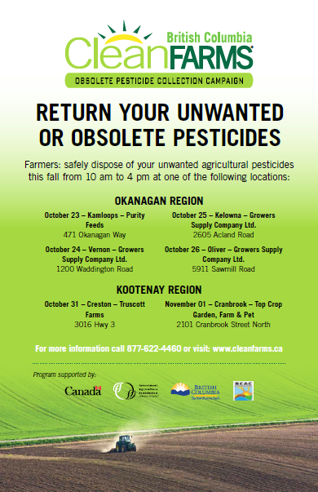
Obsolete Pesticide Collection Program
British Columbia
Hosted at 14 collection locations in Interior, Okanagan, Kootenay and Peace Regions
Combination of ag-retailers, municipal sites & fairgrounds
One-day collections (9-4)
Program funded by CleanFARMS (and BC Government $180K)
47,013 kgs collected

Slide 16
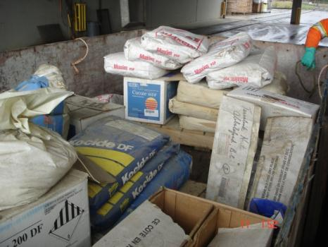
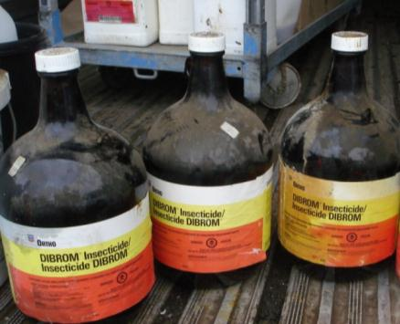
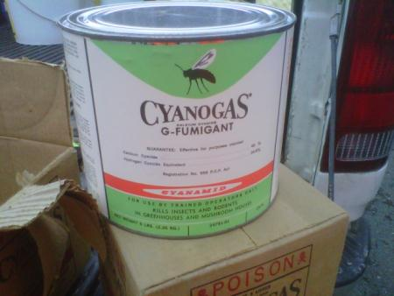
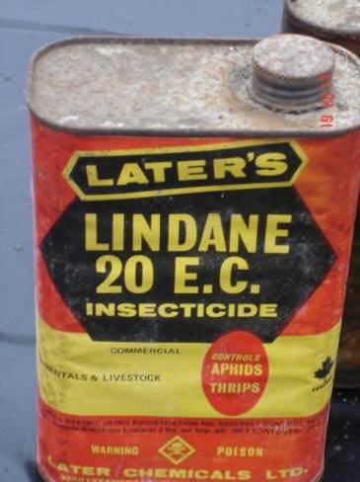
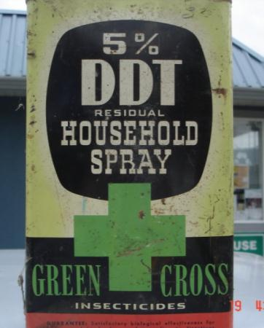
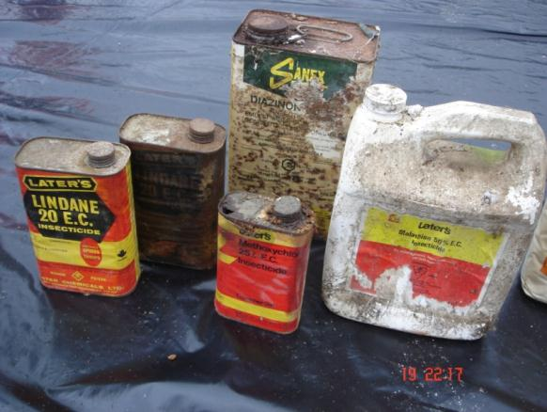

Slide 17
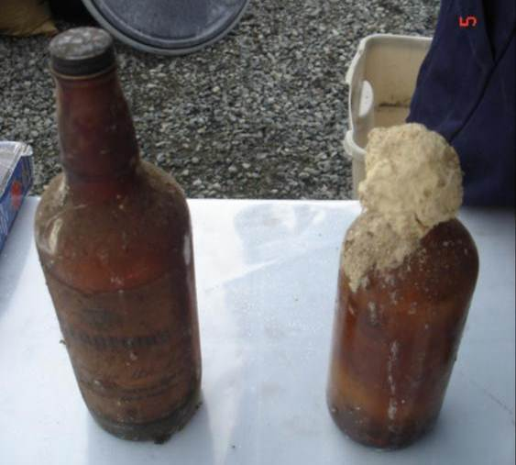
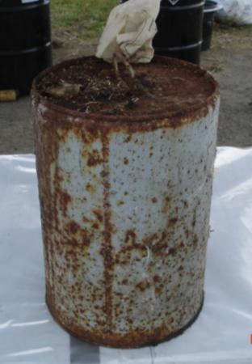
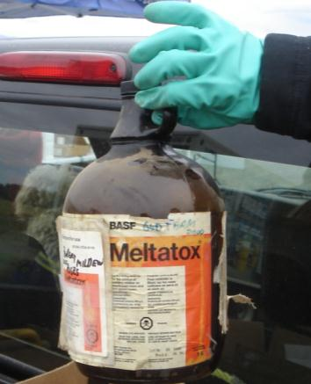
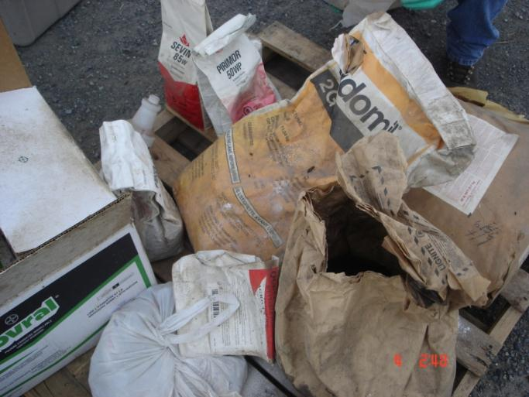
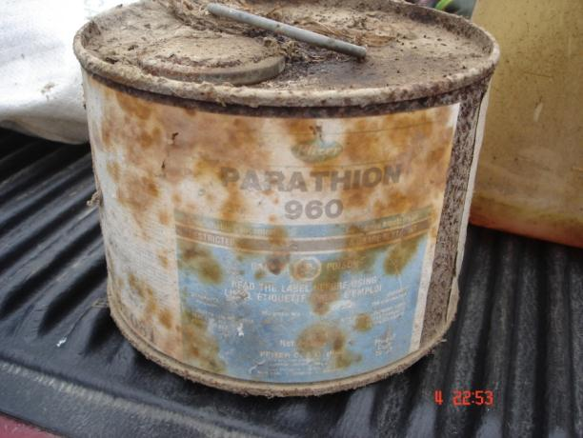

Slide 18
3. How did you hear about the program?

Slide 19
4. On average, what is the length of time you have owned the pesticides

Slide 20
5. Why do you have obsolete/unwanted pesticides?

Slide 21
Animal Health Products
2009 Pilot (Ontario)
2012 Program (Manitoba)
Drivers
  Regulation
  Grower requests
  Corporate responsibility
  Government Co-funding
What is in it for CleanFARMS?

Slide 22
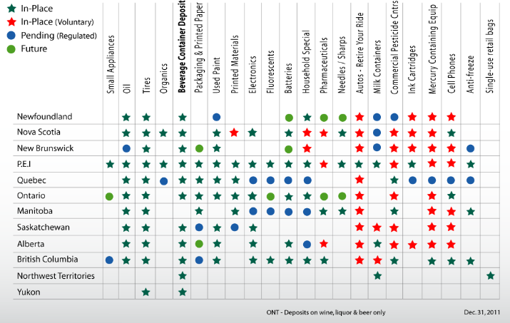
Canadian Stewardship and EPR Programs

Slide 23
Lessons Learned
Waste characterization
  Types of products (liquid, pills, pastes, etc)
Organization
  Communication (joint +++)
  Waste designation
  Site comfort levels with product
  Cannibalization by veterinarians
  Pesticide volumes vs Animal Health
  Accessibility

Slide 24
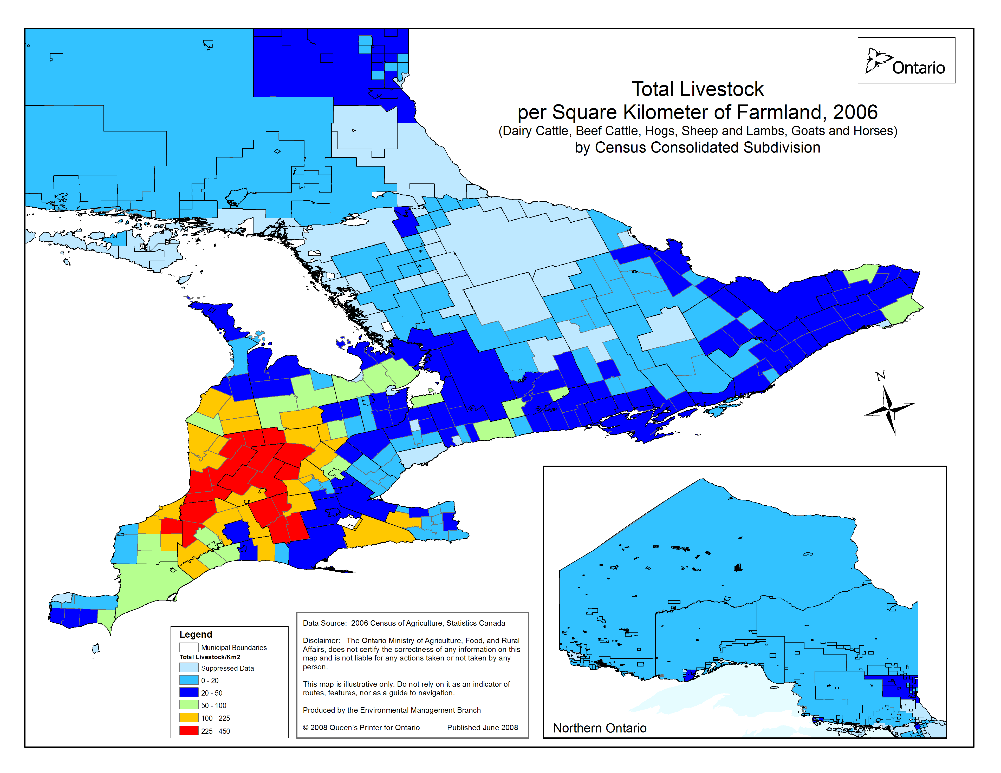

Slide 25
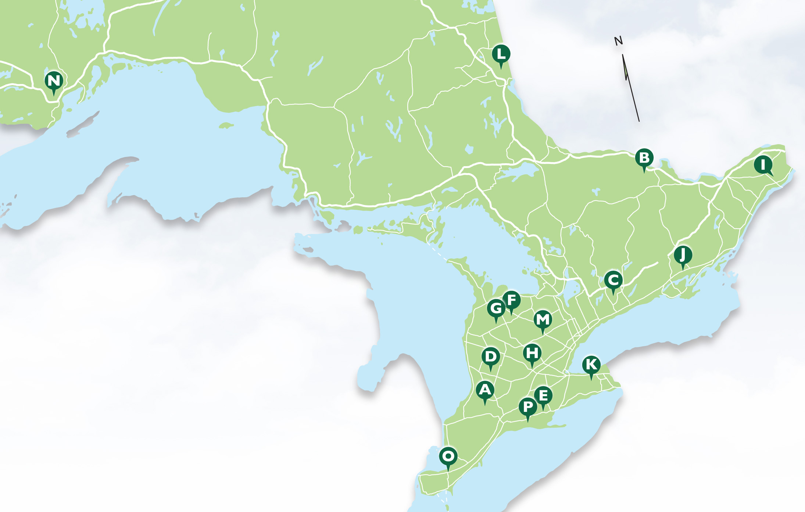

Slide 26
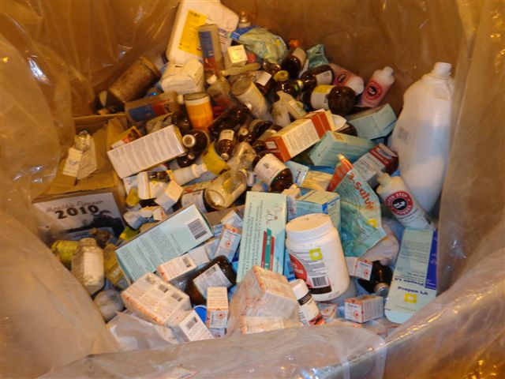

Slide 27
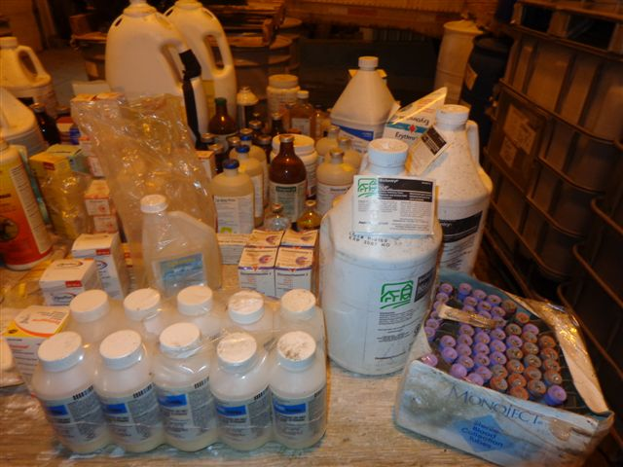

Slide 28
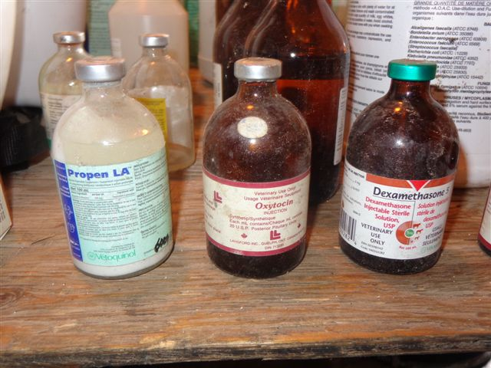

Slide 29
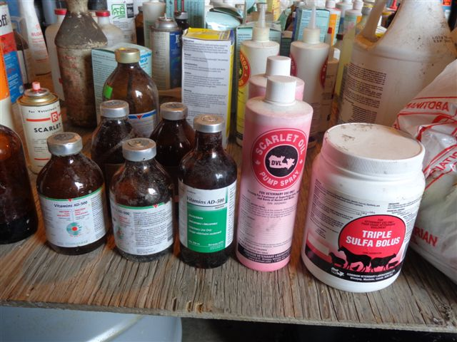

Slide 30
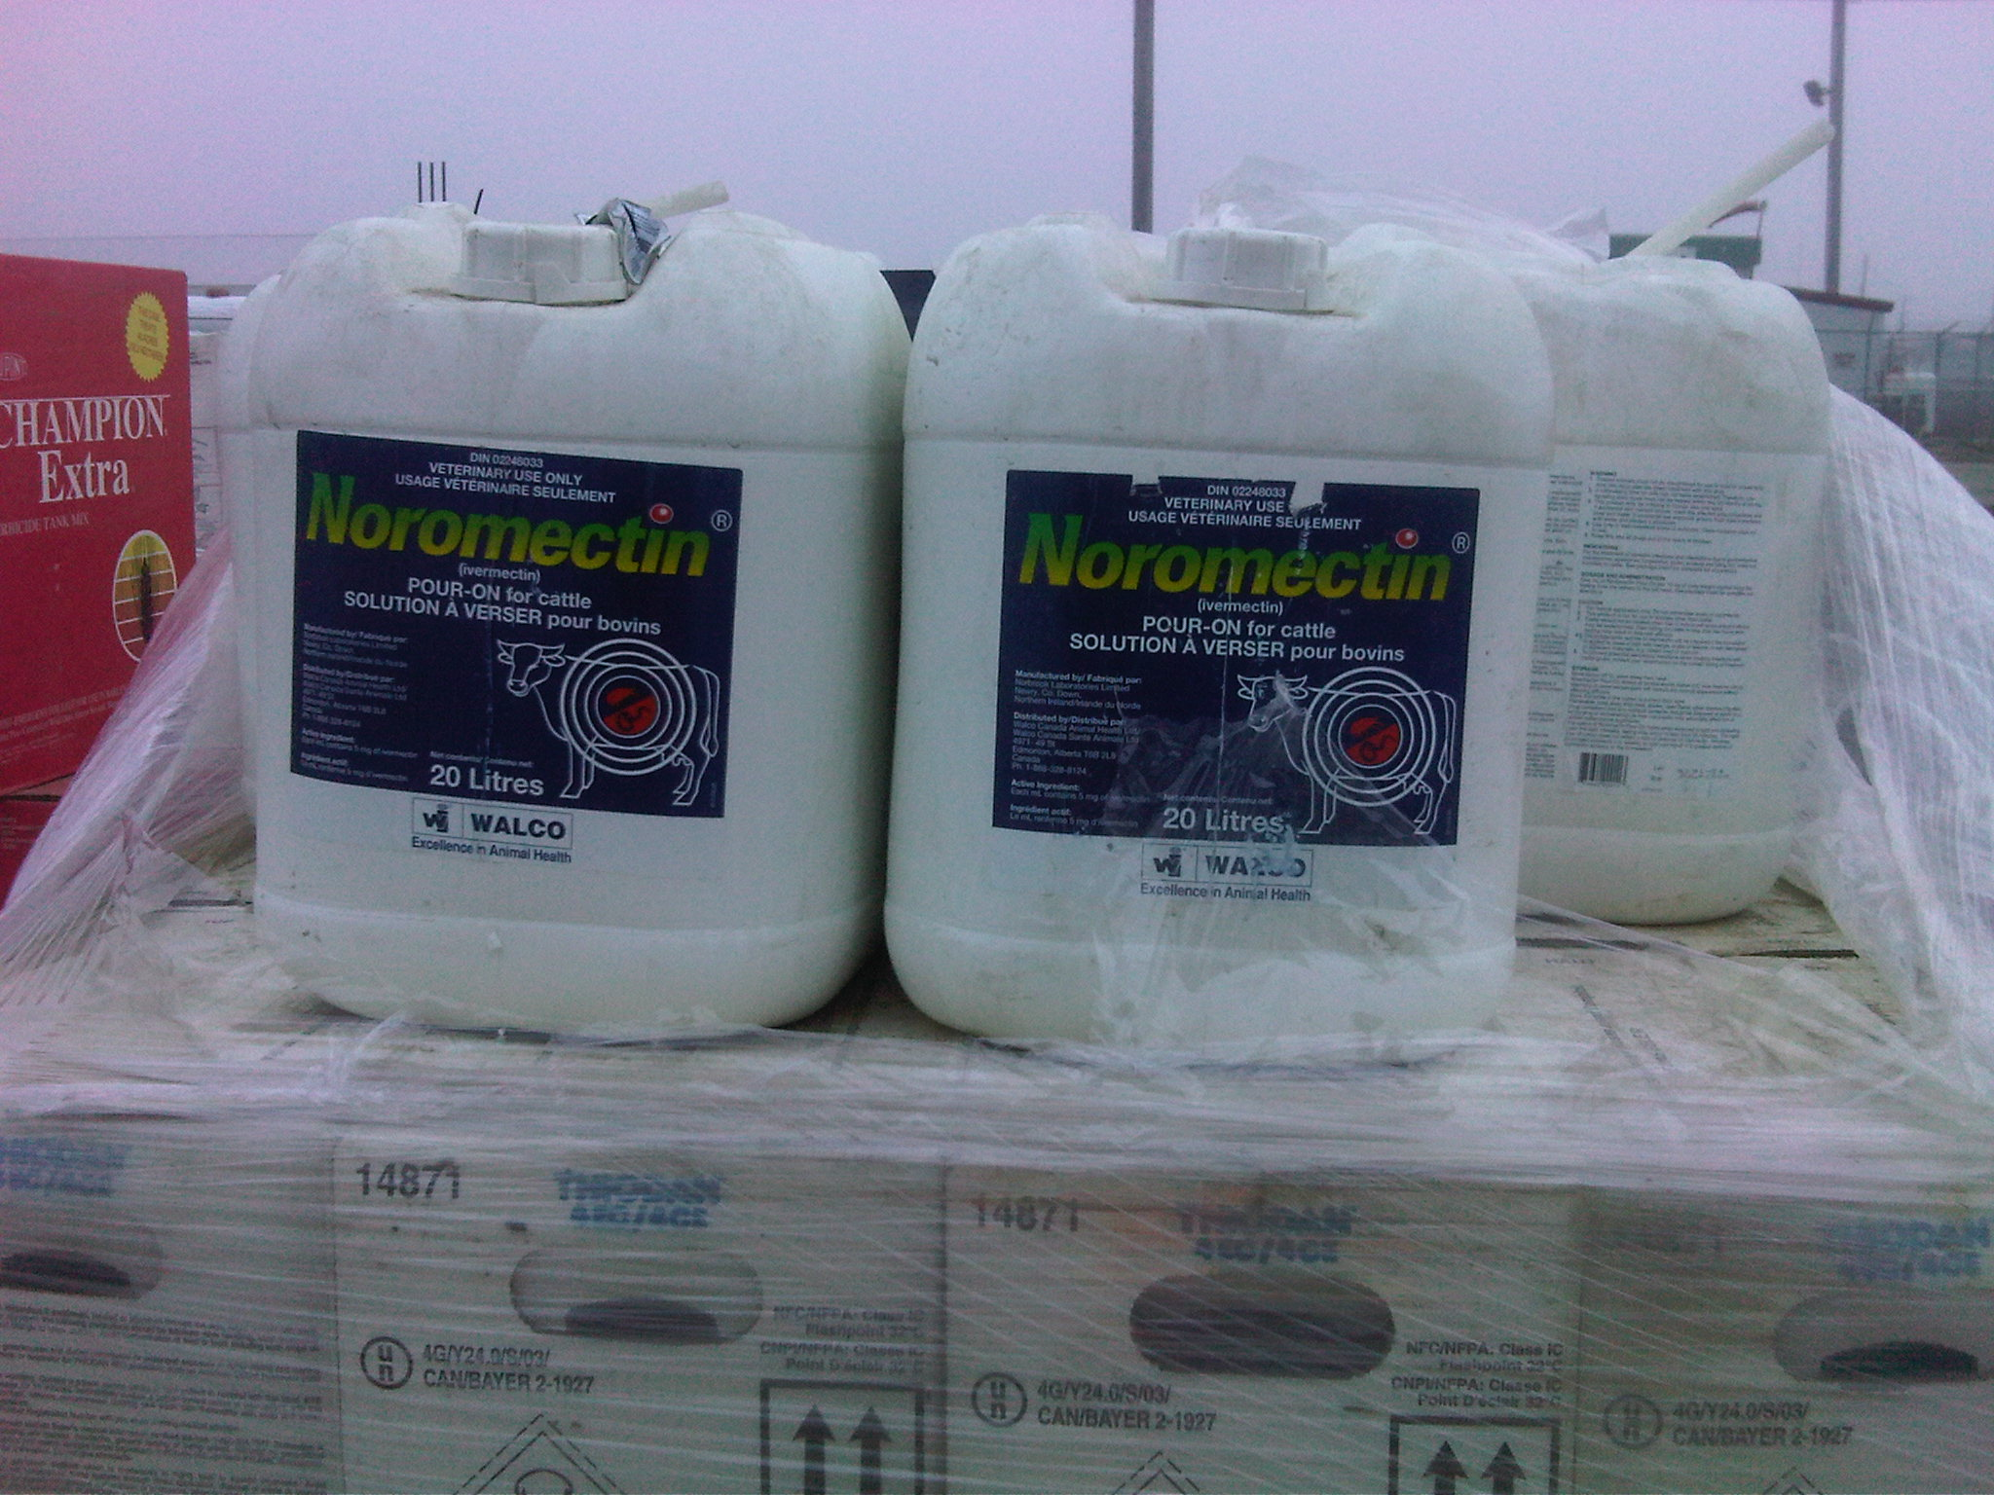

Slide 31
Future Opportunities
Key considerations:
Stewardship regulation
Core vs non-core business
Financial implications
Move to mature/permanent program?
Other models?

Slide 32
Questions?
Russel Hurst
CleanFARMS
hurstr@cleanfarms.ca

