Slide 1
Pesticide Environmental Stewardship Website: An Online One-stop Shop
http://pesticidestewardship.org
Wayne Buhler, Ph.D. Pesticide Safety Extension Specialist
North Carolina State University
Raleigh, NC

Slide 2
“…emblematic”

Slide 3
Website Topics
Calibration
Container Management
Disposal
Drift Management
Integrated Pest Management
Personal Protective Equipment
Pollinator Protection
Recordkeeping
Resistance
Soil Fumigation
Spill Prevention and Cleanup
Storage
Surface and Groundwater
Transportation
Wildlife Protection
Worker Protection Standard
Organic Crop Production (draft)
Pesticide Safety for the Homeowner
How to Read the Label

Slide 4
The Pesticide Environmental Stewardship (PES) Website is:
A Central Repository…
Web Portal…
One-stop Shop
for up-to-date information
on proper pesticide use.
Target Audience…
Anyone (trained or untrained)
who handles pesticides,
provides advice or training concerning their use,
or who has concerns
about pesticides in the environment

Slide 5
PES Website Goals
Provide a portal/hub for pesticide stewardship information
Direct users to resources (links) by stewardship topic
Develop on-line programs for recertification of licensed pesticide applicators or to prepare users for state certification exams
Link to eXtension (extension.org)

Slide 6
Funding, Personnel, and Partnerships
Financial support provided by the Center for Integrated Pest Management (CIPM)
Four coordinators representing the Midwest, Northeast, South and West will work with Extension, government, industry, and environmental organizations to identify and/or develop the best resources for a holistic approach to PES.
The Coordinators are associated with the national Pesticide Safety Education Program (PSEP).
Ron Gardner, Cornell
Jim Wilson, SDSU
Clyde Ogg, NE
Fred Whitford, Purdue
Carol Black, WSU
Carrie Foss, WSU
Wayne Buhler, NCSU

Slide 7
Supporting Organizations
BASF Bayer CropScience Certification and Training Assessment Group (CTAG) CropLife America Delta F.A.R.M. Dow AgroSciences DuPont Crop Protection Entomological Society of America's (P-IE Section) EPA Pesticide Worker Safety Programs Herbicide Resistance Action Committee (HRAC) Insecticide Resistance Action Committee (IRAC) Monsanto National Agricultural Aviation Association (NAAA) National Association of County Agricultural Agents (NACAA) National Pest Management Association (NPMA) National Pesticide PPE Training Solutions Committee (NIOSH) Syngenta Crop Protection The Pesticide Stewardship Alliance (TPSA) Responsible Industry for a Sound Environment (RISE) Weed Science Society of America (WSSA)

Slide 8
Website Construction and Maintenance
MS SharePoint with technical support and maintenance from Cornell Univ.
http://pesticidestewardship.org

Slide 10
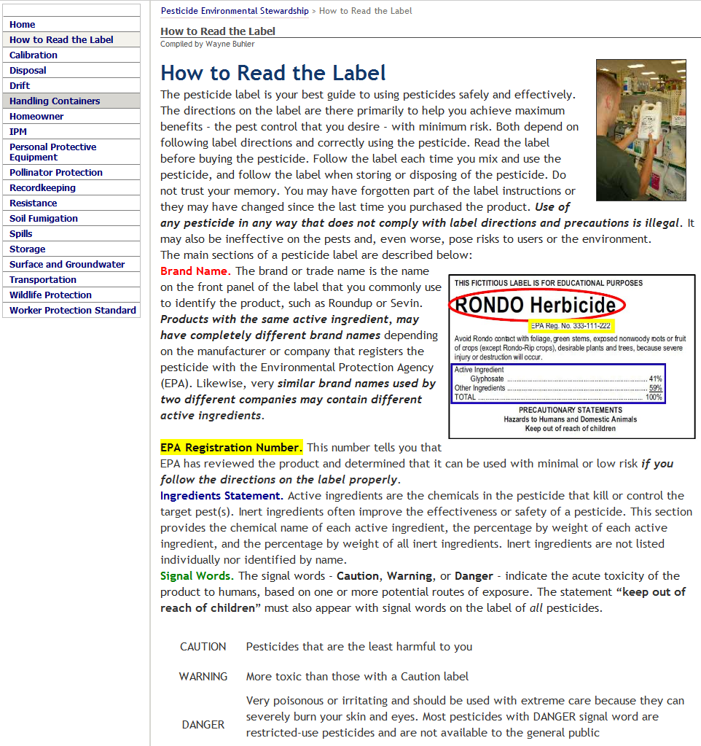

Slide 11
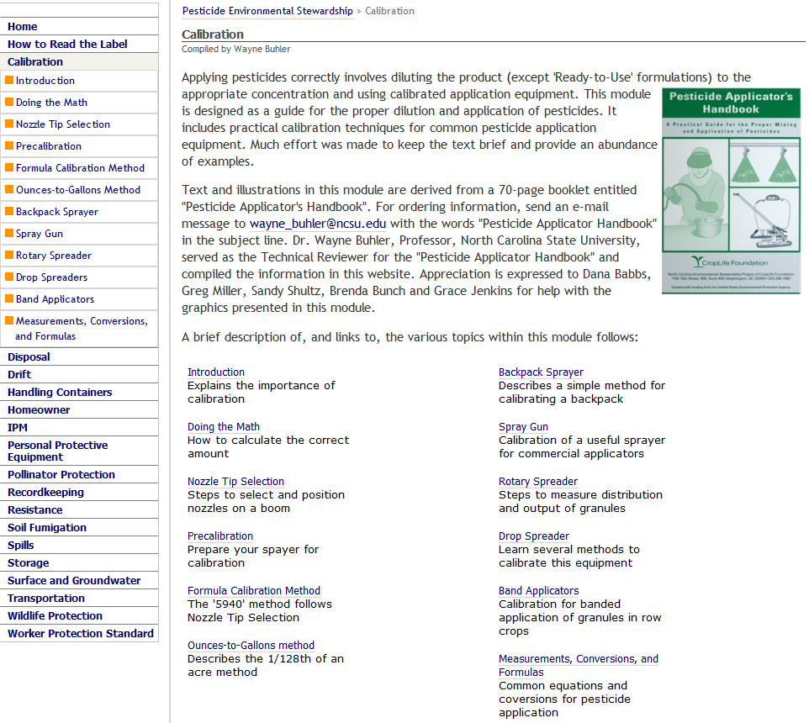

Slide 12
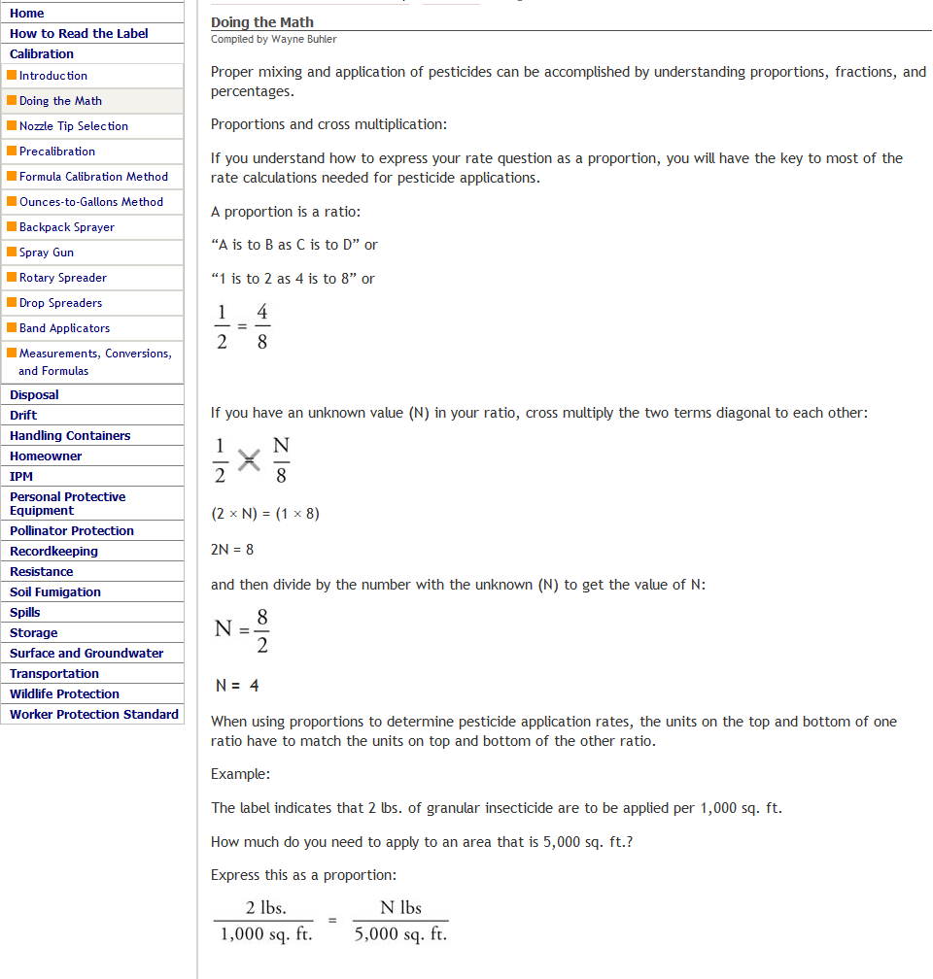

Slide 13
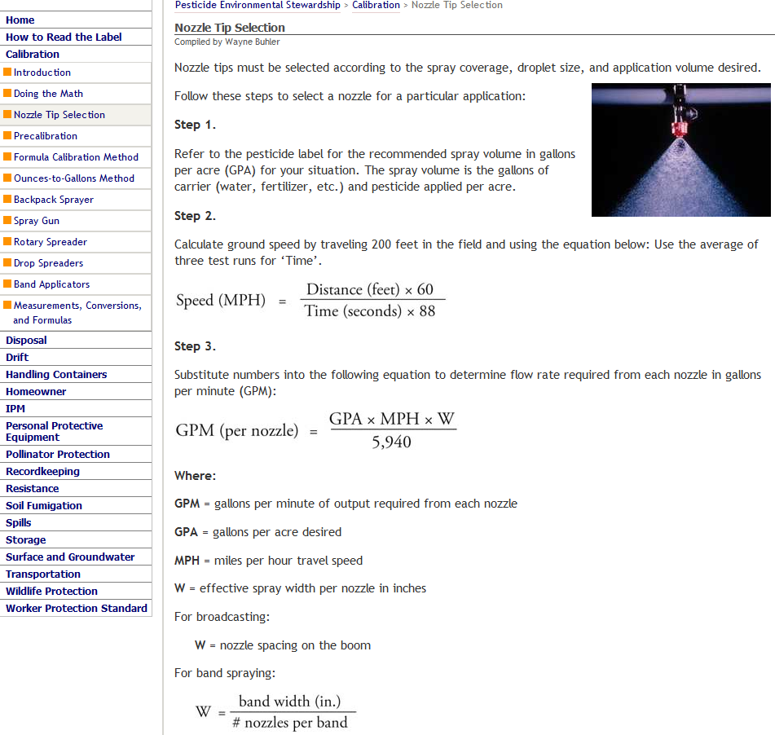

Slide 14
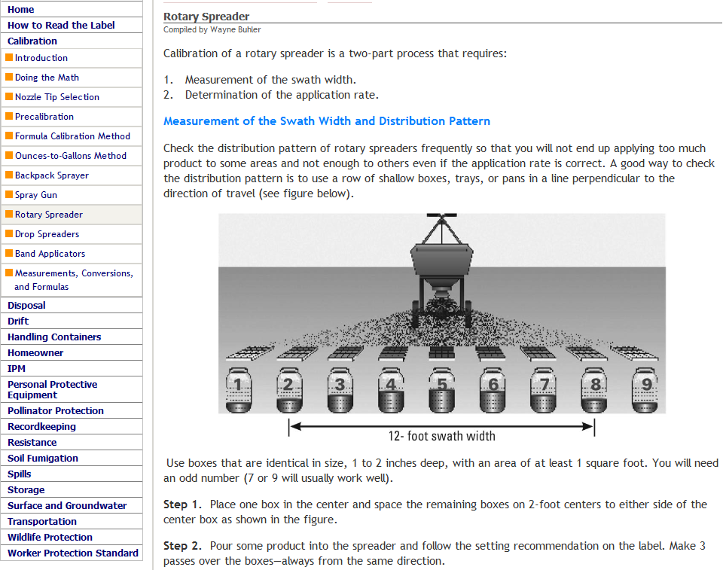

Slide 15
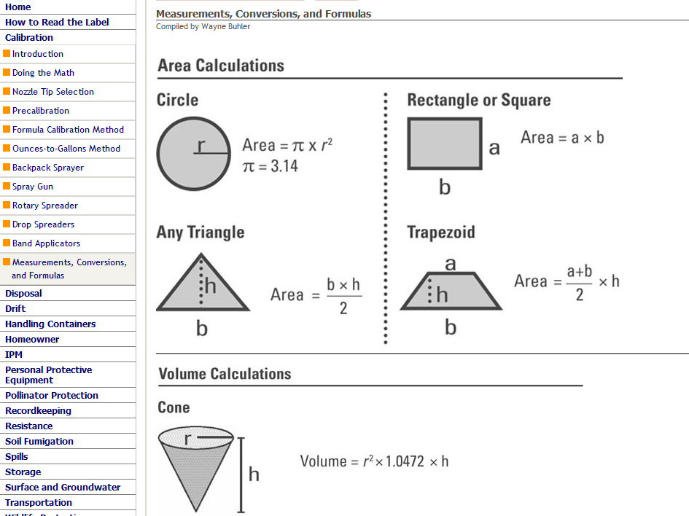

Slide 16
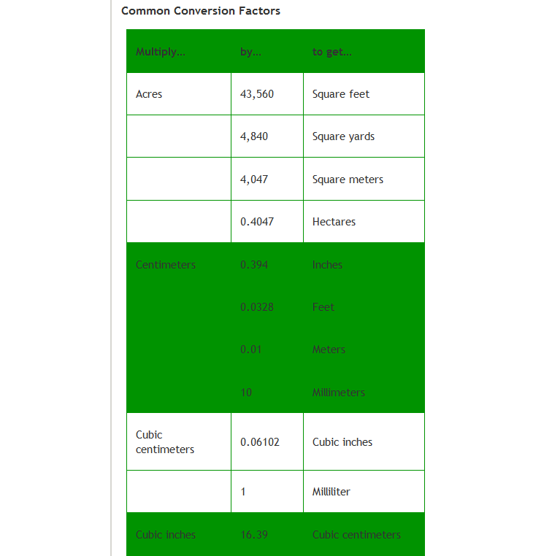

Slide 17
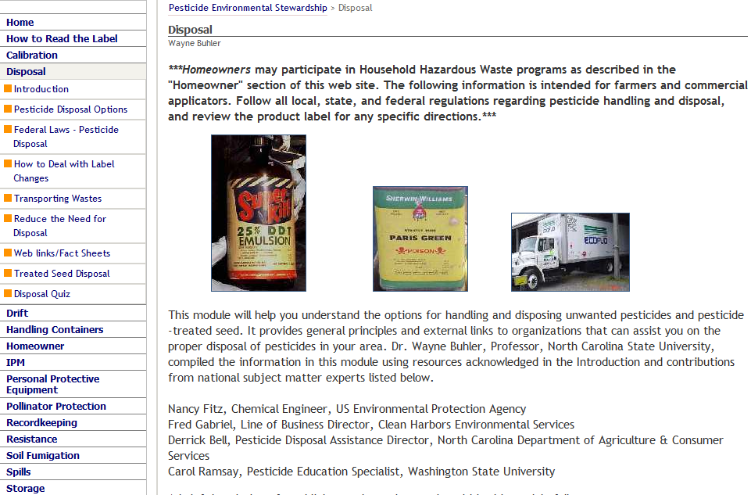

Slide 18
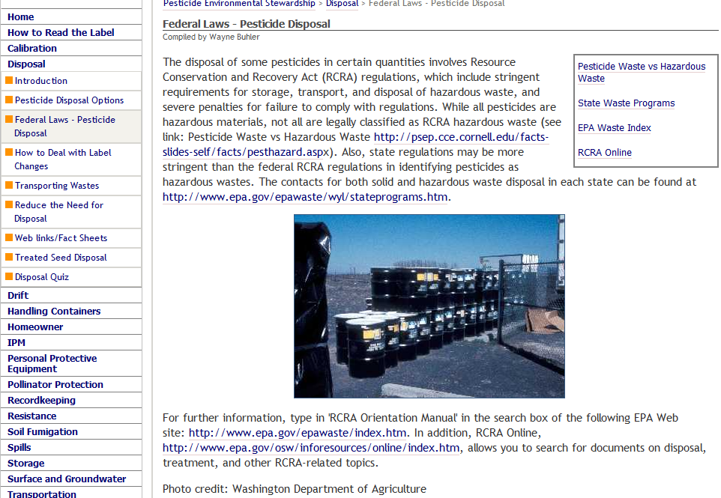

Slide 19
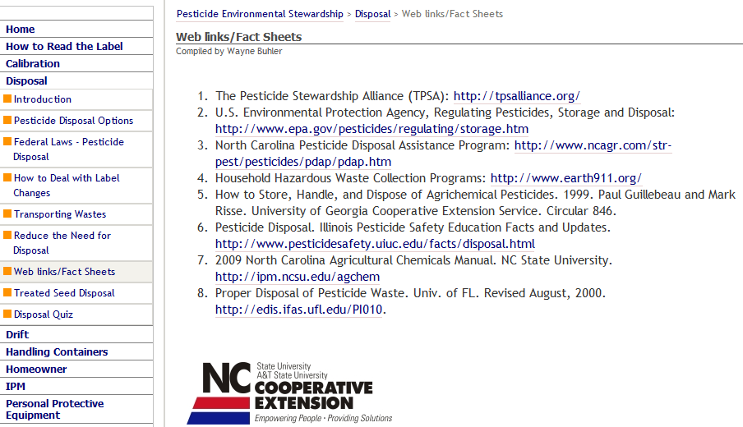

Slide 20
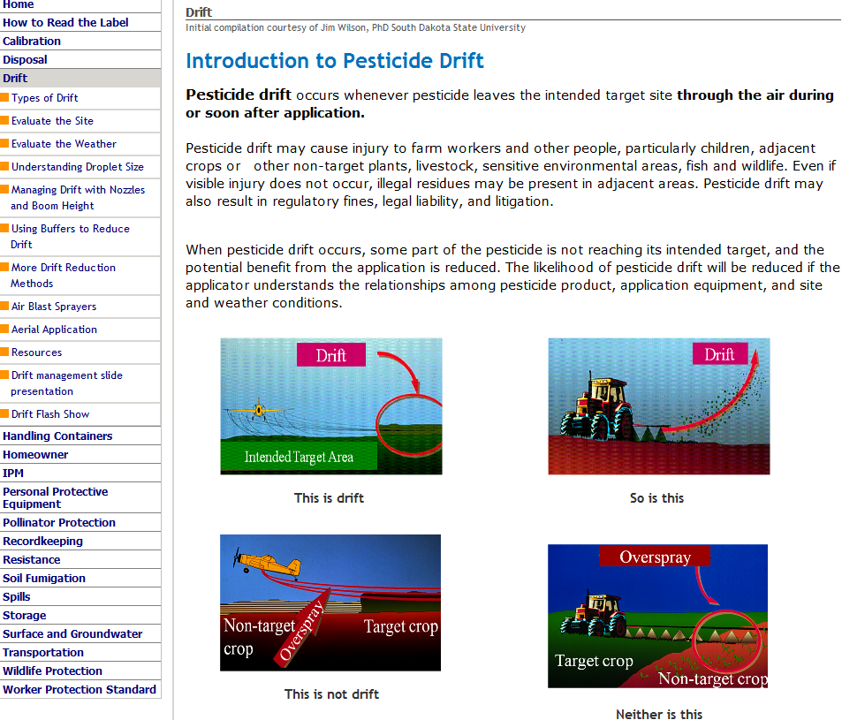

Slide 21
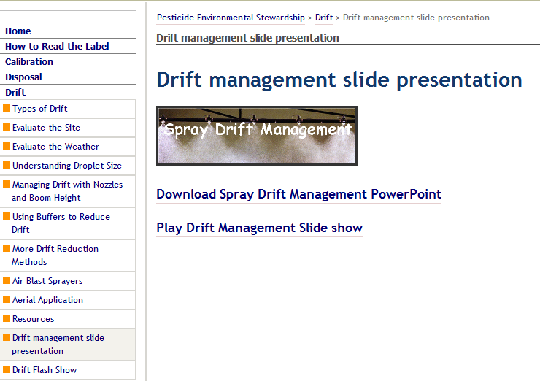

Slide 23
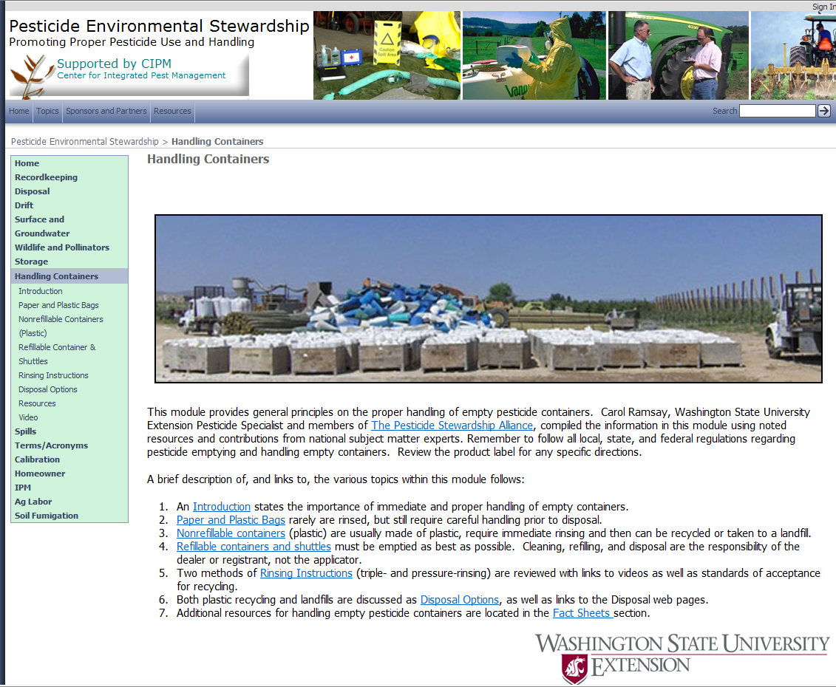

Slide 24
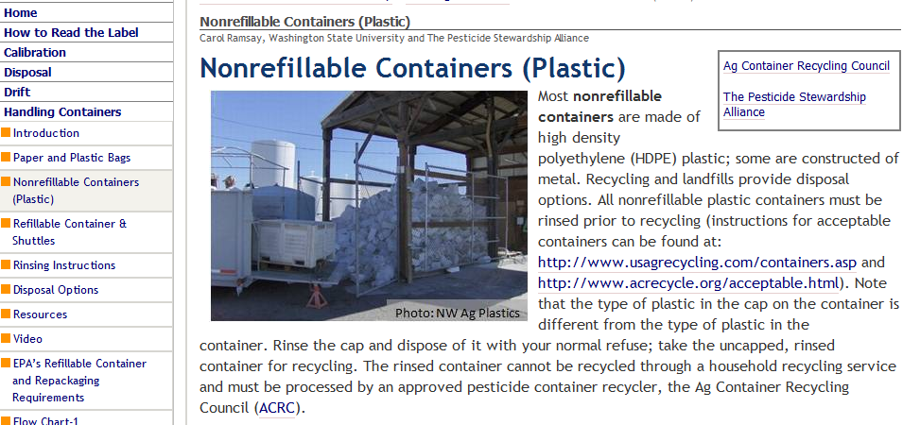

Slide 25
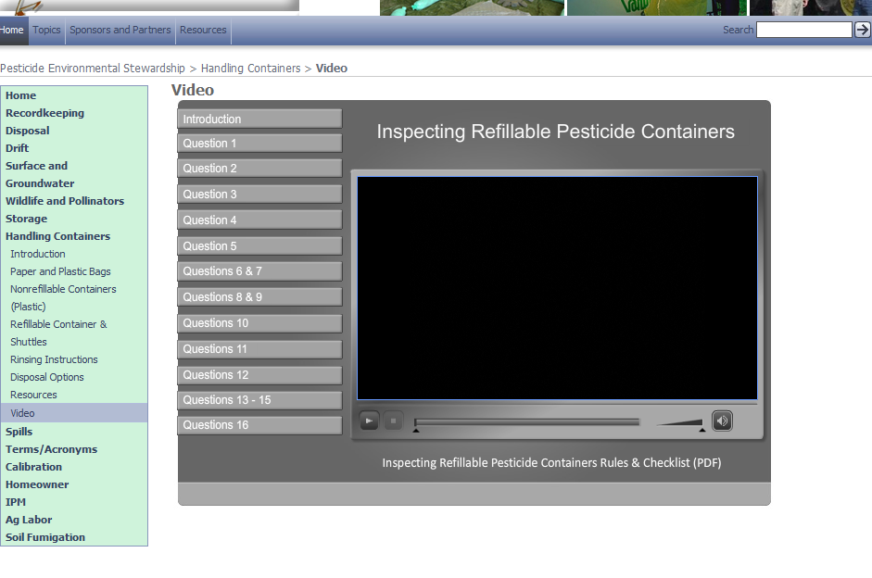

Slide 26
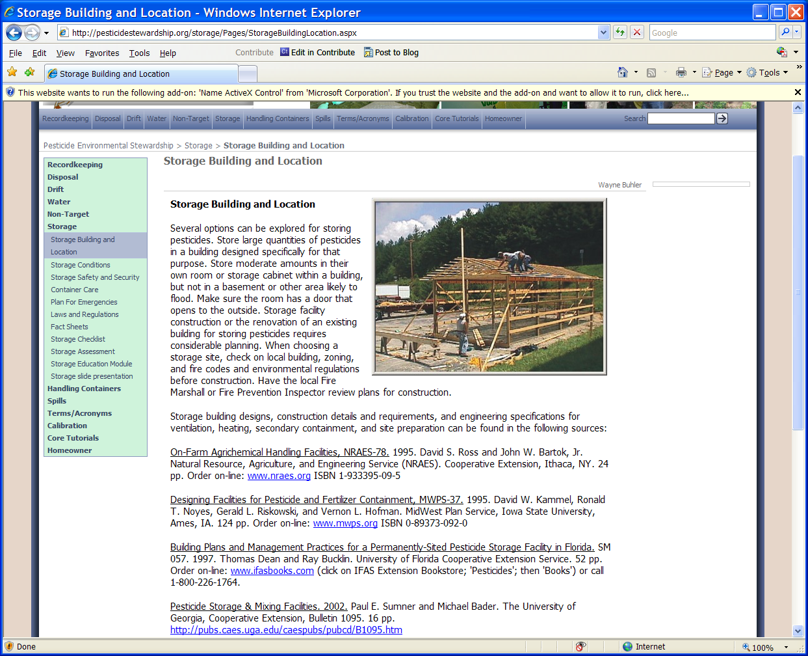

Slide 27
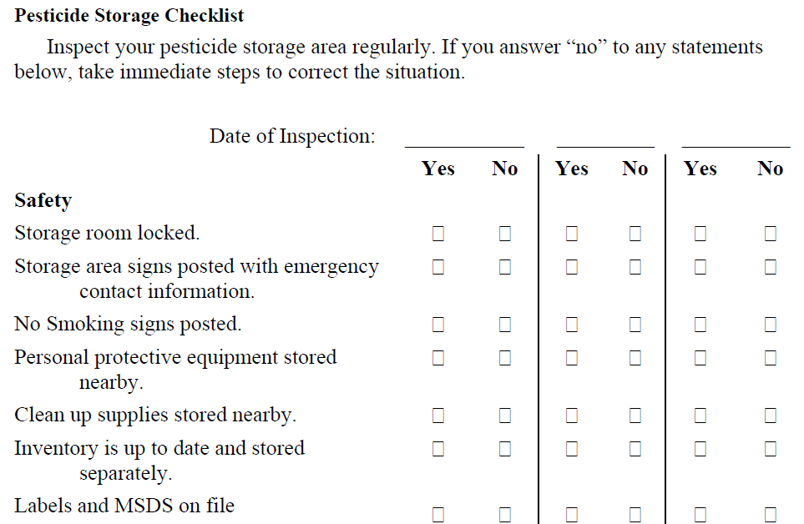

Slide 28
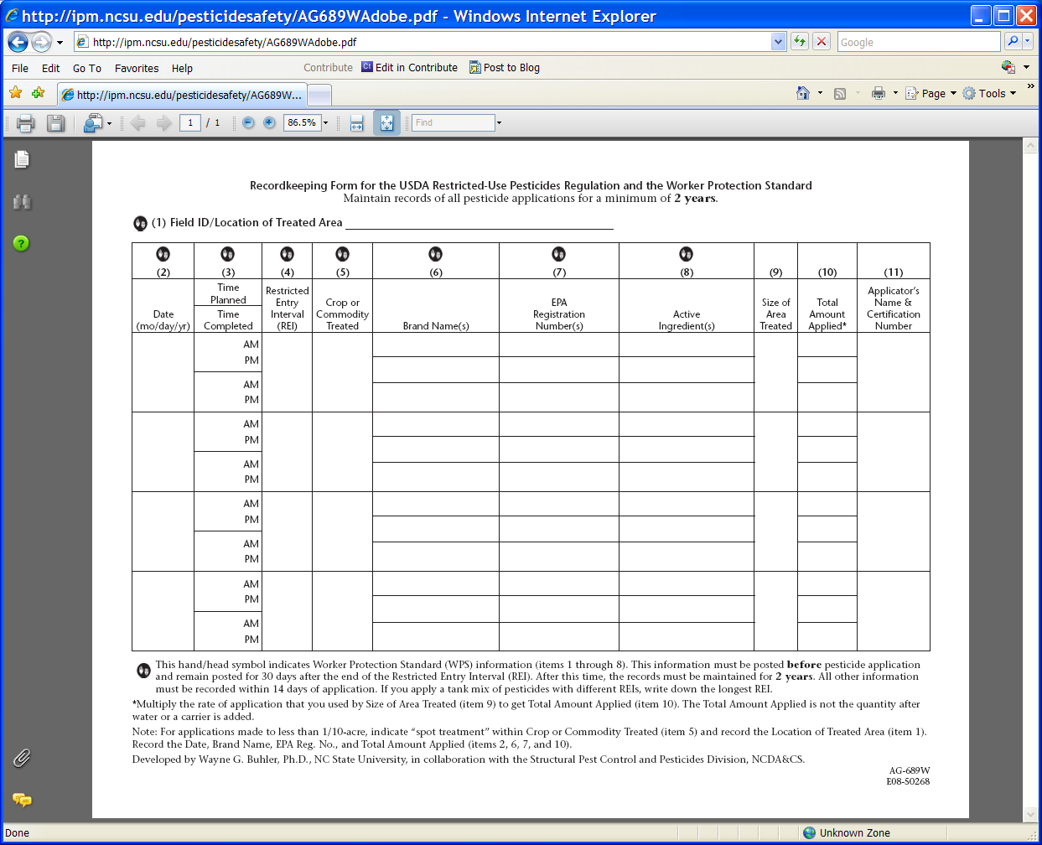

Slide 29
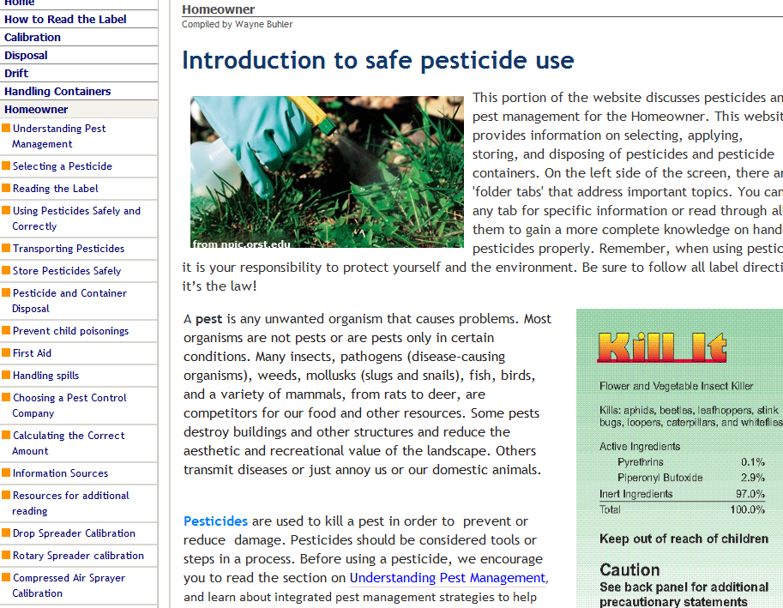

Slide 30
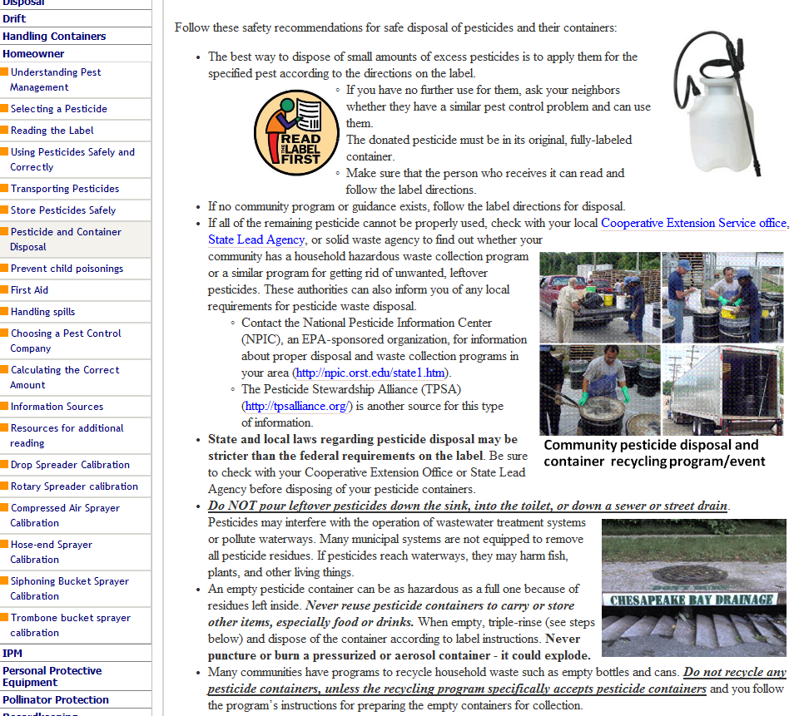

Slide 31
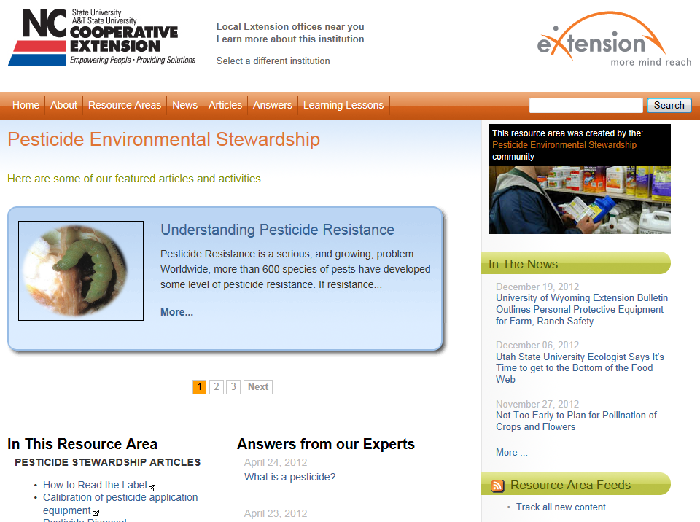

Slide 32
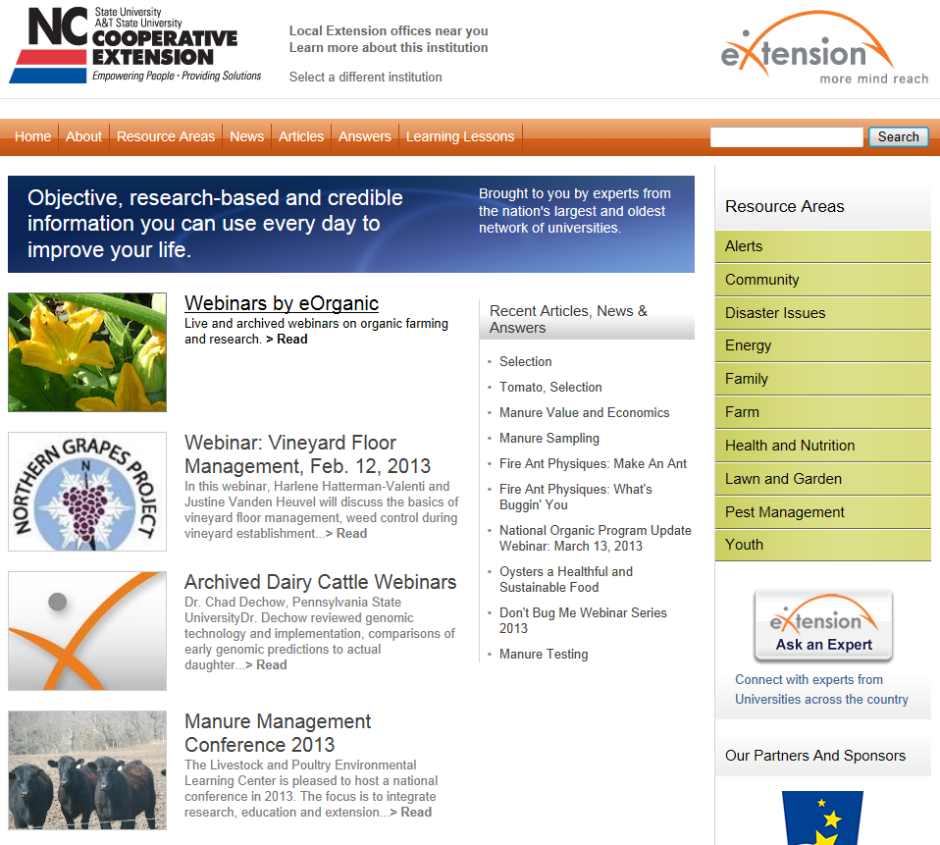

Slide 33
Pesticide Environmental Stewardship Website
http://pesticidestewardship.org
Reviewers and input needed:
wayne_buhler@ncsu.edu
919-515-5369

